Slide 1
BRIGHT MOTORS
Car Sales Analysis
Data Analytics Project
Ethaba Mhlongo

Slide 2
Project Overview
The project
An analysis of vehicle sales for Bright Motors, built into an Excel workbook with pivot tables, graphs and a dashboard.
The dataset
100,000 vehicle sales (one row per sale) with 19 fields, from December 2014 to July 2015. It covers 51 makes, 703 models and 34 states.
The purpose
To summarise car sales performance in a clear, simple way for the Head of Sales.
What I wanted to understand
Which makes and models bring in the most revenue, where and when vehicles sell, which body types and model years sell most, and how mileage relates to price.

Slide 3
Tools & Workflow
SQL
Excel
Claude
Canva
Inspect and clean the data
Filter, transform and analyse the dataset
Create the data needed for the analysis
Pivot tables on the cleaned data
Graphs and charts
The final dashboard
AI assistant during the project
Analysis ideas, presentation structure, interpreting findings
Organising the project and communicating results
Used for project planning
WORKFLOW
Raw Data
SQL
Cleaned Data
Excel Pivot Tables
Excel Graphs
Dashboard
Insights

Slide 4
Top 15 Car Makes by Total Revenue
WHAT IT SHOWS
Total revenue (sum of selling price) for the 15 makes with the highest revenue.
INSIGHT
Ford leads with $259.9M, almost double Chevrolet ($136.6M). Ford, Chevrolet and Nissan together make up 37.2% of total revenue.

Slide 5
Top 15 Car Models by Total Revenue
WHAT IT SHOWS
Total revenue for the 15 models with the highest revenue.
INSIGHT
F-150 is the top model at $49.0M, followed by Altima ($39.7M) and Escape ($33.0M).

Slide 6
Sales by Region
WHAT IT SHOWS
Number of vehicles sold in each state.
INSIGHT
FL (15,501) and CA (14,746) record the most sales. The top five states (FL, CA, TX, GA, PA) account for 50.7% of all sales.

Slide 7
Sales by Manufacturing Year
WHAT IT SHOWS
Number of vehicles sold for each manufacturing year.
INSIGHT
Vehicles from 2012 have the most sales (18,237). Model years 2012 to 2015 together make up 52.4% of sales.

Slide 8
Average Selling Price by Year
WHAT IT SHOWS
Average selling price for each manufacturing year.
INSIGHT
Average price rises with newer vehicles: $581 for 1990 models, $16,397 for 2012 and $26,196 for 2015.

Slide 9
Monthly Sales Trend
WHAT IT SHOWS
Number of vehicles sold in each month of the data.
INSIGHT
February 2015 is the highest month (35,345 sales), then January 2015 (30,514). April 2015 (310) and July 2015 (190) are the lowest of the main months.

Slide 10
Top 10 Body Types by Number of Sales
WHAT IT SHOWS
Number of vehicles sold for the 10 most common body types.
INSIGHT
Sedan (44,622) and SUV (25,567) are the most sold body types, together 70.2% of all sales.

Slide 11
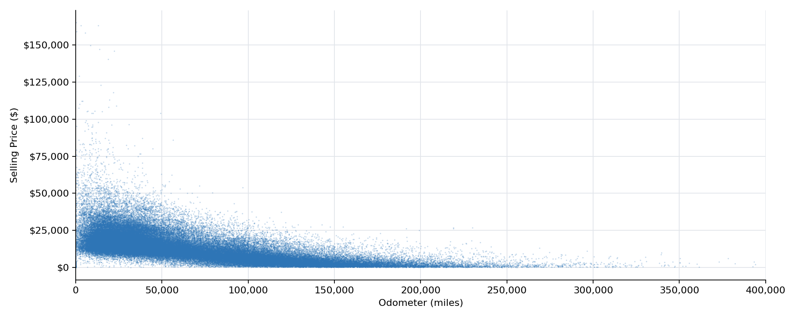
Mileage vs Selling Price
WHAT IT SHOWS
Each point is one sale: odometer reading against selling price. Axis shown to 400,000 miles.
INSIGHT
Selling prices are highest for low-mileage vehicles and fall as mileage increases. Vehicles under 20,000 miles average $21,038; those over 150,000 miles average $3,318.

Slide 12
Dashboard Summary
TOTAL SALES
100,000
TOTAL REVENUE
$1,357,115,159
AVG SELLING PRICE
$13,571
AVG MILEAGE
67,103
TOTAL MAKES
51
TOTAL MODELS
703
SUMMARY
Ford, Chevrolet and Nissan lead revenue (37.2%)
FL, CA, TX, GA, PA make up 50.7% of sales
Most sales fall in Dec 2014 to Feb 2015 (75.9%)
Sedans and SUVs are 70.2% of sales

Slide 13
Recommendations & Key Insights
Key Insights
Recommendations
Ford, Chevrolet and Nissan generate 37.2% of total revenue; F-150 is the top model.
FL, CA, TX, GA, PA account for 50.7% of sales.
Sedans and SUVs make up 70.2% of sales.
75.9% of sales fall between December 2014 and February 2015.
Newer model years sell at higher average prices; higher mileage goes with lower prices.
Prioritise stock and promotion for the top makes and models: Ford, Chevrolet, Nissan; F-150, Altima, Escape.
Focus sales effort on FL, CA, TX, GA, PA.
Keep sedans and SUVs as the core of the inventory mix.
Review why April (310) and July 2015 (190) are so low before planning around seasonality.
Use model year and mileage when setting prices.

Slide 14
Conclusion
What the analysis found
100,000 sales generated $1,357,115,159 in revenue
Ford leads revenue; F-150 is the top model
FL and CA lead sales by region
Sedans and SUVs dominate sales; most sales fall in Dec 2014 to Feb 2015
Newer, lower-mileage vehicles sell at higher prices
How each tool contributed
SQL: inspected, cleaned and prepared the data
Excel: pivot tables, graphs and the dashboard
Claude: analysis ideas, interpreting findings and communicating results
Canva: project planning
This project shows an end-to-end data analytics process: cleaning data in SQL, analysing and visualising it in Excel, and turning the results into clear insights.

